Slide 1
College Orientation
College Prep
Mr. Gordon
jgordon@bisdtx.org

Slide 2
Upcoming Events
hi

Slide 3
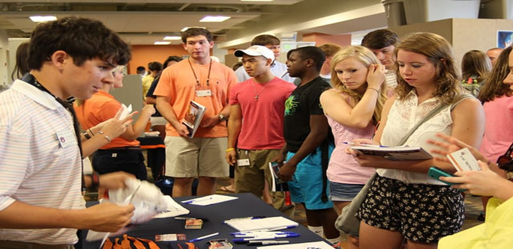
What is College Orientation?
College Orientation is a way for universities to prepare incoming students for the transition from high school to college.
College orientation usually occurs over the summer between your high school graduation and first semester of college.
You must be admitted to the university to register for and attend orientation.
hi

Slide 4
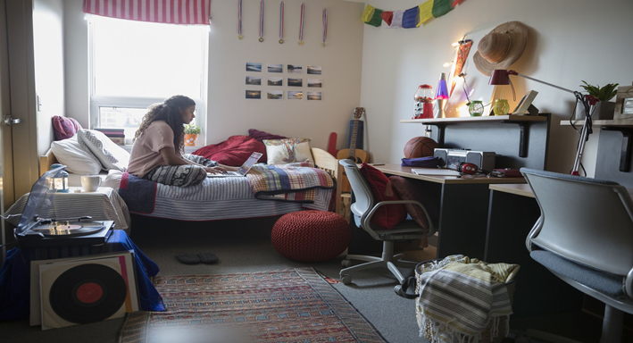
What is College Orientation?
Registration for orientation is usually first-come, first-serve, so we always recommend to reserve your spot as early as possible.
Some university orientations are just one day, but many are two days long and require a night staying in a dormitory or hotel.
hi

Slide 5
What happens at Orientation?
You will take a tour of the campus, see dorm rooms, eat in the cafeteria, and possibly meet some of your professors.
You will meet with a financial aid advisor to go over your student loans, grants, and scholarships.
You will meet with an academic counselor to pick your classes for the upcoming semester.
You will get your university ID printed.
hi

Slide 6
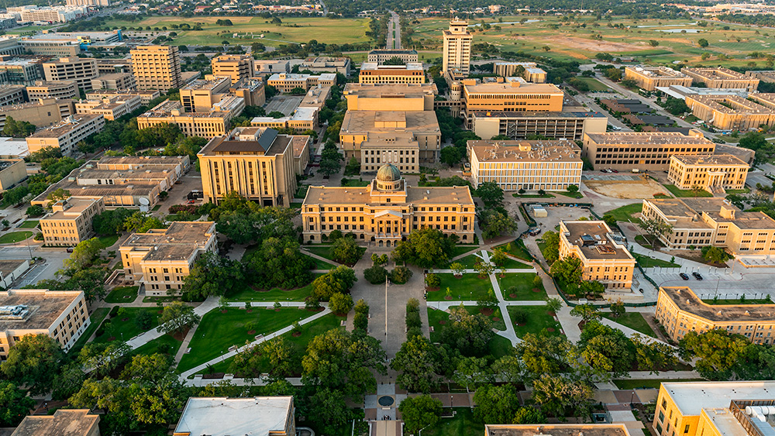
What happens at Orientation?
You will meet your future roommates!
You will play games/ icebreakers with other incoming students.
Many times parents are invited to come. They will have a chance to visit the campus and meet with a financial aid advisor.
hi

